Slide 1
Phone Components
Click the next slide and decide on what components you want to include in your app. You need to choose 3 components and 1 DB.

Slide 2
Component | What it does
Camera, speaker, microphone | Allow you to take pictures, videos, record sounds
GPS | Shows the location of the phone
Storage on a phone | Allows you to store preferences, images, sounds on the your phone
Connectivity to the web | Allows you to connect the phone to information on the web
Accelerometer, gyroscope | Shows how fast the phone is moving
Phone calls, text messages, contacts lists | Allows you to make phone calls, send text messages, and connect to people

Slide 3
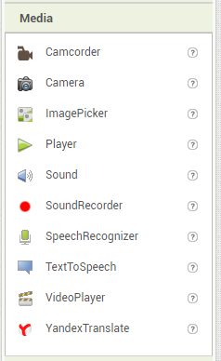
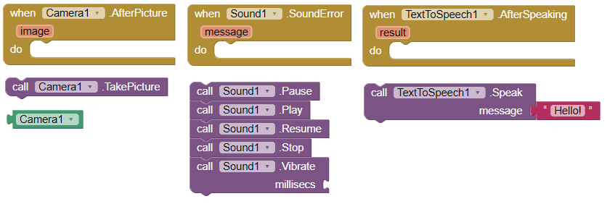
Camera
Speaker Phone
Microphone
Allow you to take pictures, videos, record sounds

Slide 4
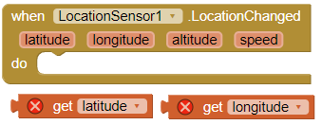
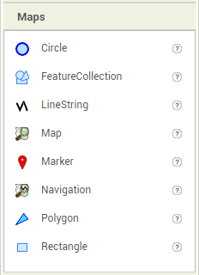
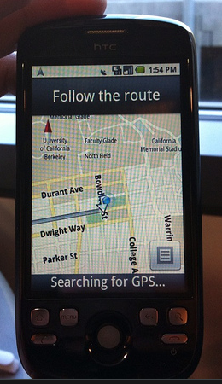
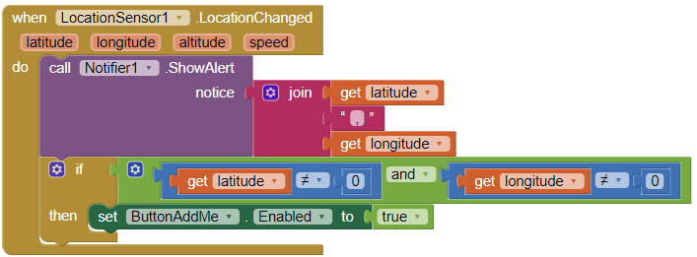
GPS
Shows the location of the phone
Mark points on a map

Slide 5
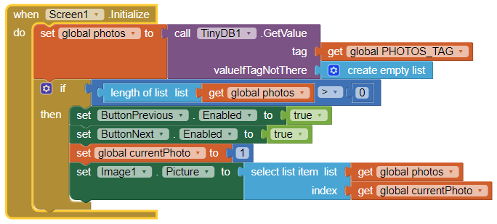
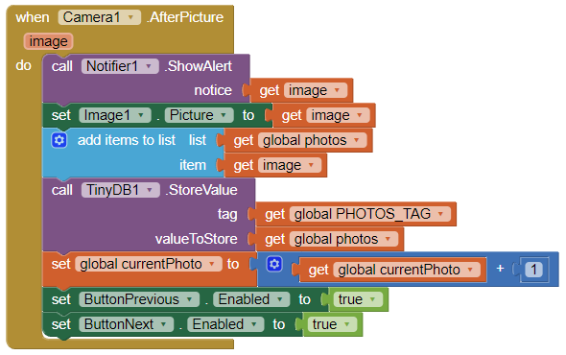
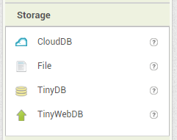
Storage on a phone
Allows you to store preferences, images, sounds on the your phone
These code snippets show part of a slide show app that allows you to take and save pictures using a TinyDB.

Slide 6
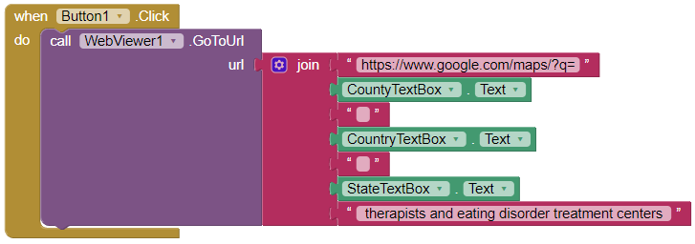
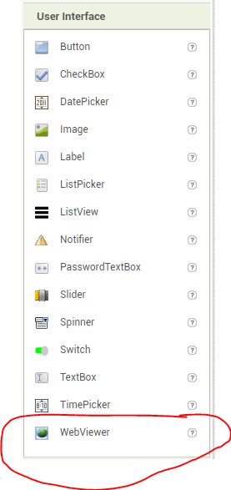
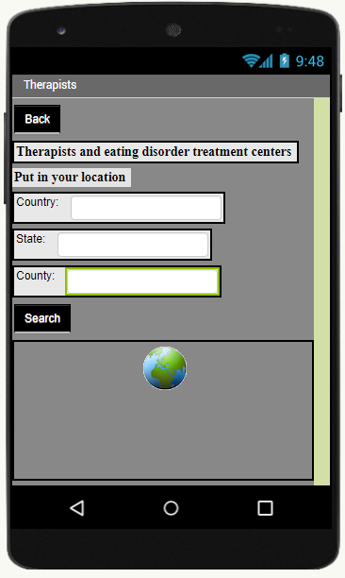
Connectivity to the web
Allows you to connect the phone to information on the web
This app allows you to enter search criteria and see locations on a map based on your search.
This can be found in the User Interface Drawer.
You can use the WebViewer to direct users to informational websites, YouTube, Web Images, etc.

Slide 7
Accelerometer
Gyroscope
Shows how fast the phone is moving

Slide 8
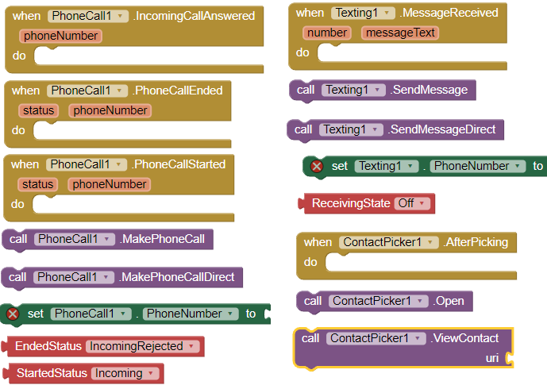
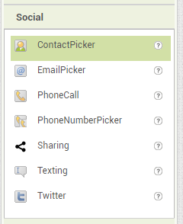
Phone calls
Text messages
Contacts lists
Allows you to make phone calls, send text messages, and connect to people

